Slide 1


M.Tech/MCA Program
Advanced Industry Integrated Programs
Jointly offered by University and LTIMindTree
Review III
Multi-Agent AI Travel Planner with Real-Time Guidance
Team Member
Kaviya V
M. Tech (Artificial Intelligence and Machine Learning)
VIT Vellore
Knowledge partner | Implementation partner

Slide 2
Multi-Agent AI Travel Planner with Real-Time Guidance
Introduction
Combines LLM intelligence with Google Maps precision.
Generates dynamic itineraries.
Recommends personalized points of interest.
Supports multilingual voice input.
Enables shareable trip links.

Slide 3
Multi-Agent AI Travel Planner with Real-Time Guidance
Objective
Personalizes itineraries using LLMs.
Integrates real-time geographic data.
Recommends diverse POIs.
Enables interactive map visualizations.
Supports shareable links and modular architecture.

Slide 4
Multi-Agent AI Travel Planner with Real-Time Guidance
Module name
User Interface & Interaction Layer:
Voice Input Processing.
User Interface Design & Display.
AI Planning & Optimization Engine:
AI-Based Itinerary Generation.
Cost Prediction via Machine Learning.
Real-Time Route Optimization.
Multilingual Translation Support.

Slide 5
Multi-Agent AI Travel Planner with Real-Time Guidance
Module name
Data Presentation & Export Module:
Dynamic Map Generation & Visualization.
Printable HTML Itinerary.
Shareable Trip Link Creation.
Data Persistence & Storage Layer:
Database for Saving & Loading Trip Data.
Admin & Analytics Dashboard:
Performance Monitoring & User Analytics.
AI Model Effectiveness Reporting.

Slide 6
Multi-Agent AI Travel Planner with Real-Time Guidance
Problem Statement
No Starting Point:
Users struggle to turn vague ideas into structured plans.
Budget Confusion:
No reliable, dynamic cost estimates based on trip details.
Outdated Routes:
Static plans ignore live traffic, causing inefficiencies.
Limited Sharing:
Itineraries stuck in apps—no easy, portable format.
Accessibility Gaps:
Lack of voice input limits usability for diverse users.

Slide 7
Multi-Agent AI Travel Planner with Real-Time Guidance
Methodology
LLM + ML Integration:
Combines LLM for creative planning with LightGBM for cost prediction.
Synthetic Data Generation:
Uses LLM to generate training data for the cost model.
Predictive Modeling:
Employs LightGBM for high-performance cost estimation.

Slide 8
Multi-Agent AI Travel Planner with Real-Time Guidance
Methodology
Auto Hyperparameter Tuning:
Uses Optuna for optimal model configuration.
Real-Time API Integration:
Connects to Google Maps APIs for live traffic and routing.
User-in-the-Loop Workflow:
Interactive UI triggers all AI planning and optimization.
Continuous Monitoring:
Dashboard tracks AI performance and user engagement.

Slide 9
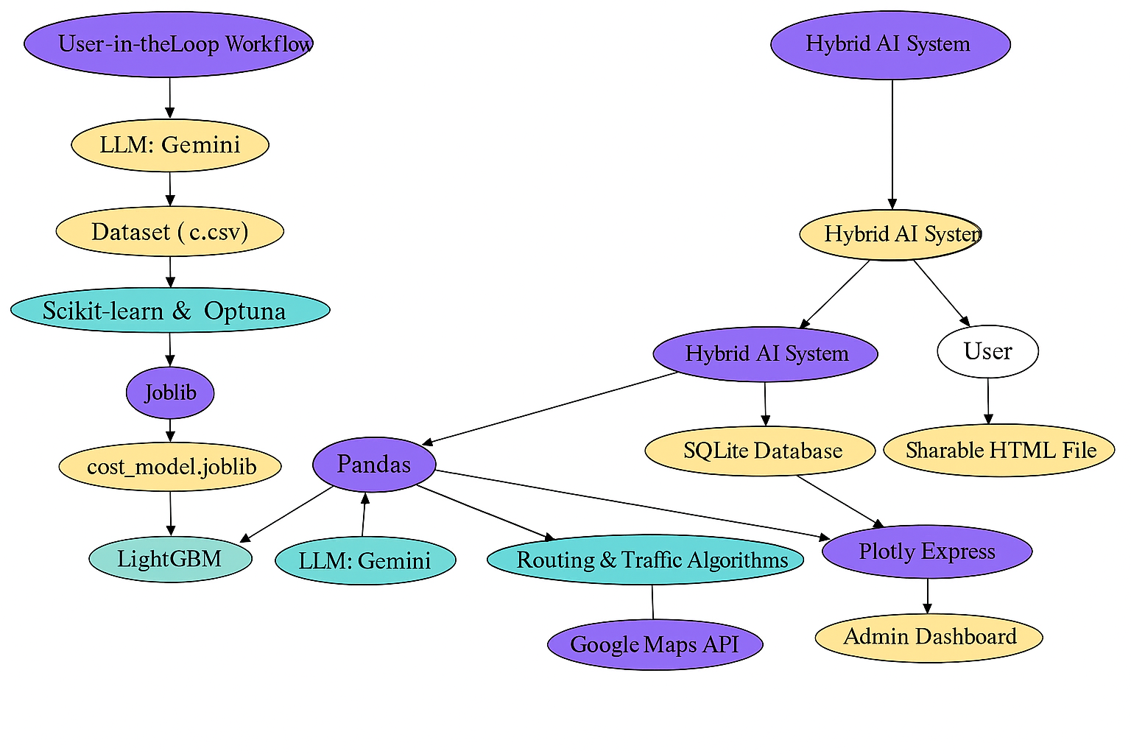
Multi-Agent AI Travel Planner with Real-Time Guidance
Approach/Algorithms/Tools

Slide 10
Multi-Agent AI Travel Planner with Real-Time Guidance
Findings and Results
Architectural Findings
Hybrid AI: LLM + ML = creative + fast predictions.
Decoupled UI/API: Scalable and resilient.
Cloud DB: Enabled shareable, stateful app.
Functional and Technical Results
Live Route Optimization: Saves real travel time.
Error Handling: Robust against API failures.
Voice + Text Input: Accessible UX.

Slide 11
Multi-Agent AI Travel Planner with Real-Time Guidance
Findings and Results
Data & Machine Learning Outcomes
Synthetic Data: LLM-generated, high-quality.
Cost Model: Accurate, budget-aware predictions.
User Experience & Deployment Results
Cloud Hosted: Publicly accessible service.
HTML Itineraries: Portable and shareable.

Slide 12
Multi-Agent AI Travel Planner with Real-Time Guidance
Conclusion
Hybrid AI Power:
Combined LLM, ML, and Maps API for smart trip planning.
End-to-End Automation:
Transforms simple prompts into detailed itineraries.
Dynamic & Accurate:
Real-time routing + cost prediction = practical planning.
Fully Shareable:
Generates portable HTML itineraries for easy access.
Scalable & Robust:
Cloud-deployed, modular, and built for continuous evolution.

Slide 13
Multi-Agent AI Travel Planner with Real-Time Guidance
Acknowledgement
Open-Source Community:
For tools like Streamlit, Pandas, and LightGBM.
Google & Microsoft:
For cutting-edge AI, cloud, and database services.
Cloud Platforms:
For enabling live, scalable deployment.
Early Testers:
For feedback that refined UX and functionality.
Optuna & Scikit-learn Developers:
For essential ML and tuning frameworks.

Slide 14
Multi-Agent AI Travel Planner with Real-Time Guidance
Reference
[1] J. Ge, B. Liu, and J. Wang, “A Multi-Agent Solution to Personalized Travel Planning,” arXiv preprint arXiv:2505.10922, May 2025.
[2] Y. Suresh, S. Joshi, S. C, S. Poojary, and S. Reddy, “Smart Travel Assistance using Machine Learning and Generative Artificial Intelligence,” in Proc. Int. Conf. on Intelligent Computing and Control Systems (ICICCS), IEEE, 2025.
[3] Z. Shao, J. Wu, W. Chen, and X. Wang, “Personal Travel Solver: A Preference-Driven LLM-Solver System for Travel Planning,” in Proc. 63rd Annual Meeting of the Association for Computational Linguistics (ACL), pp. 27622–27642, 2025.
[4] T. Primya, G. Kanagaraj, K. S, K. VK, and N. S, “GenAI-powered Itinerary Planner,” in Proc. 3rd Int. Conf. on Advancements in Electrical, Electronics, Communication, Computing and Automation (ICAECA), IEEE, 2025.

